Slide 1
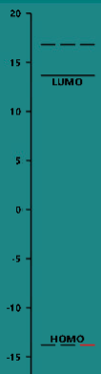
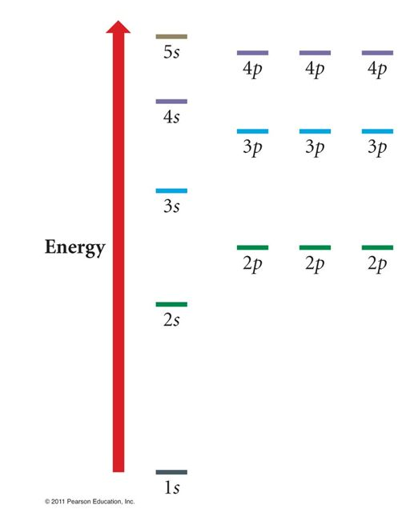
Argon
Spartan says energies (eV) are
LUMO+1 energy =+16.8
LUMO energy = +13.7
HOMO energy = -13.8

